Slide 1
Welcome to the experiment ☺
The experiment will take approximately 1h30min – 2h, and it’s split into 3 main sessions
The tasks are the same, but stimuli slightly differ
Before each session starts, you will go through the specific instructions
Here is the general instruction

Slide 2


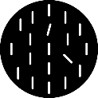
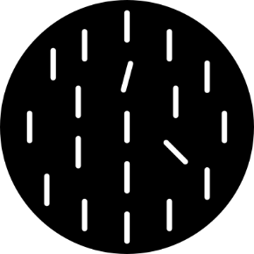

Ex)
In each trial, there will be flickering disks.
In the second and last frame of each trial, the disks will be filled with bars.
One of these disks is the target disk. Before each session, we will tell you which disk will be the target disk. Left figure shows the flow of one trial.
1st target disk
In the first target disk (second frame), there will be two tilted bars, one tilted 15° (target) and the other tilted 45°. The 45° bar is irrelevant for the task.
In the second target disk (last frame), only one bar will be tilted in 15° (target).
Bars can be tilted either to the left or to the right.
Your task is to detect whether the target bars (15° tilted bars) in the first and second target disks are tilted in the same direction or not.
If both are tilted in a same direction (both left or both right) press the left button, otherwise the right button if they are in different directions.
Target →
Irrelevant →
2nd target disk
t
Continue …

Slide 3
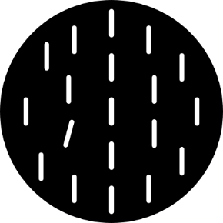
The tilted bars will always be presented in one of three positions, as shown below (red circles).
Target →
If both targets are tilted in the same direction, press the left button, otherwise the right button if they are in different directions
First disk
Second disk
First disk
Second disk
Target →
Target →
← Target
Target →
Same direction: left button (arrow)
Different direction: right button (arrow)

Slide 4
Thanks a lot for your participation! ☺

